Slide 1
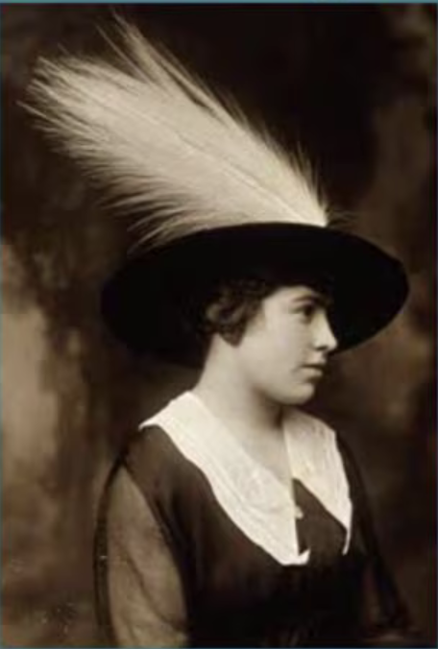
Winter Bird Counting
Medford Leas and Beyond
January 7, 2025
Laurie Larson
Medford Leas Birders

Slide 2
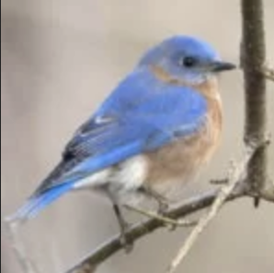
Winter Bird Counts
1. Medford Leas Winter census
2. National Audubon Christmas bird count
3. Other winter bird counts in New Jersey
4. Short video, time permitting: a citizen scientist
5. Questions

Slide 3
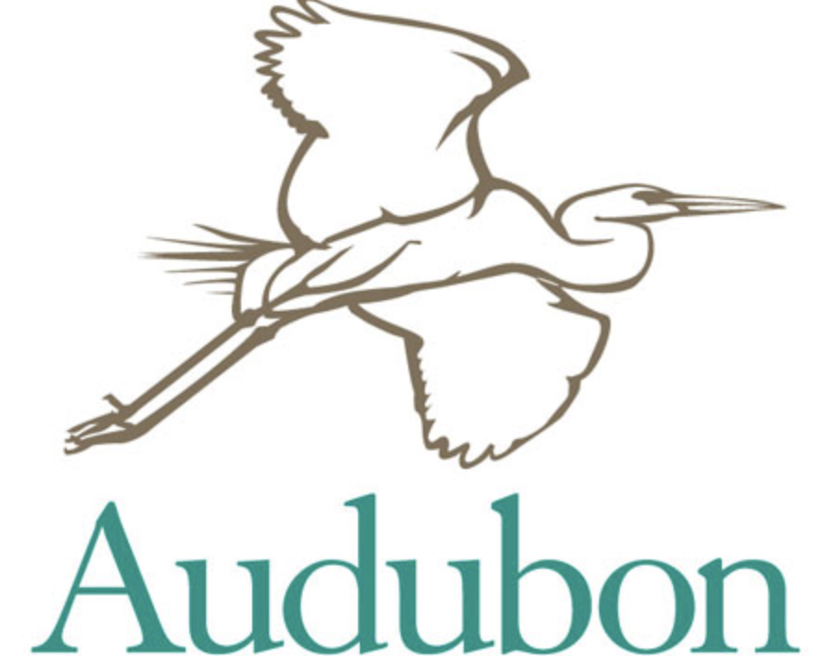
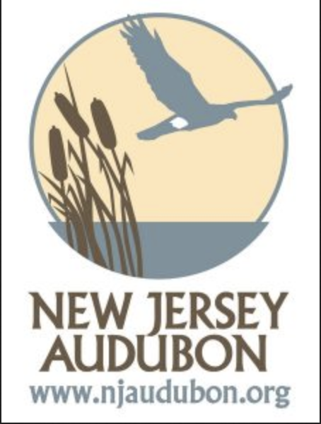
Winter Bird Counts
19th Century Bird Conservation
“Audubon movement”
to save birds from use on hats, and as targets
Watching through binoculars, not guns
Counting birds as a worthwhile activity in itself
Winter (only resident birds) as a baseline

Slide 4
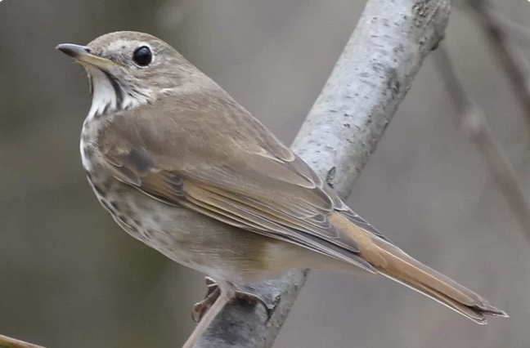
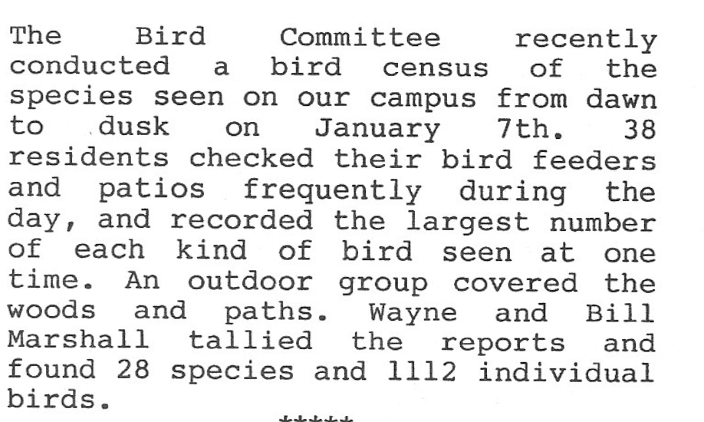
Medford Leas Winter Census
Medford Leas Life, Feb. 1989
The Medford census was started in 1988 or 1989 by Wayne, Bill, and Gertrude Marshall; the Lumberton census began in 2000.

Slide 5
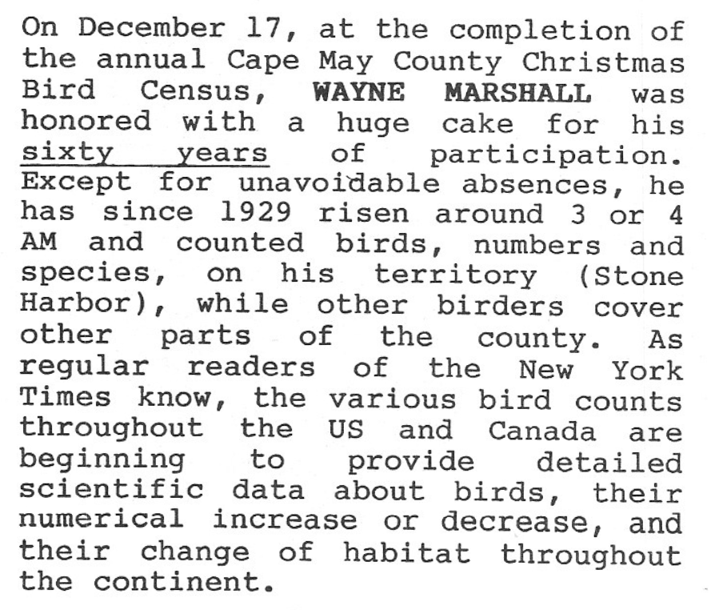
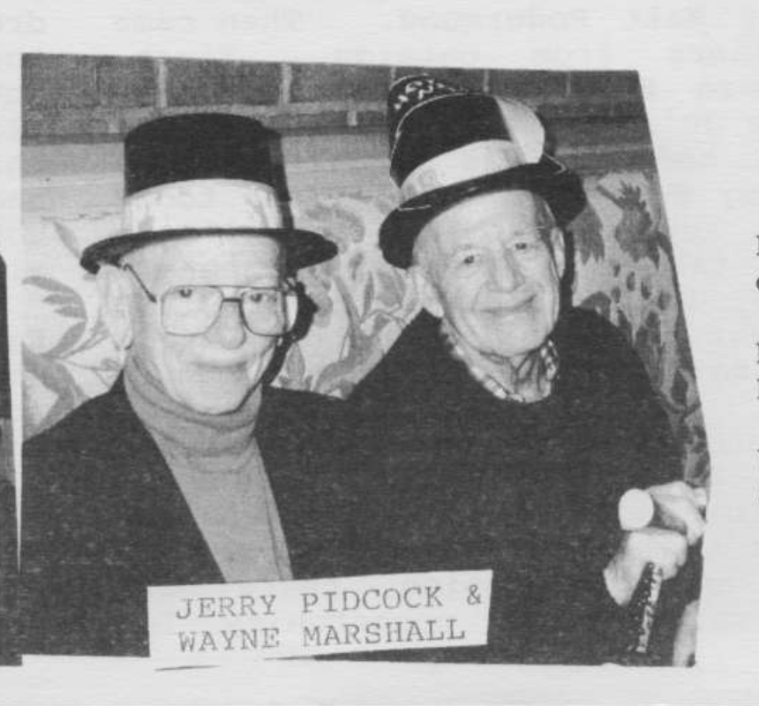
Wayne Marshall
Wayne Marshall (right)
Celebrating the New Year --
Medford Leas Life, Jan. 2000
Medford Leas Life, Feb. 1990
Marshall owned copy #101 of Witmer Stone’s Bird Studies at Old Cape May,
according to the register on the DVOC web site. It was inscribed by the author.
“Given to Edward Wayne Marshall, Jr. M.D by Stone and signed on December 16, 1937.”
Published by Philadelphia Inquirer/Philadelphia Daily News on May 9, 2004.

Slide 6
Medford Leas Winter Census
Results: Go to mlra.org/MLBirders and click the button “Reports”
https://mlra.org/MLBirders/ “Reports”
(census results, by year)
https://mlra.org/MLBirders/medford-leas-annual-census-1989-2012/
(Medford results table)
https://mlra.org/MLBirders/winter-census-summary/
(Lumberton results table)

Slide 7
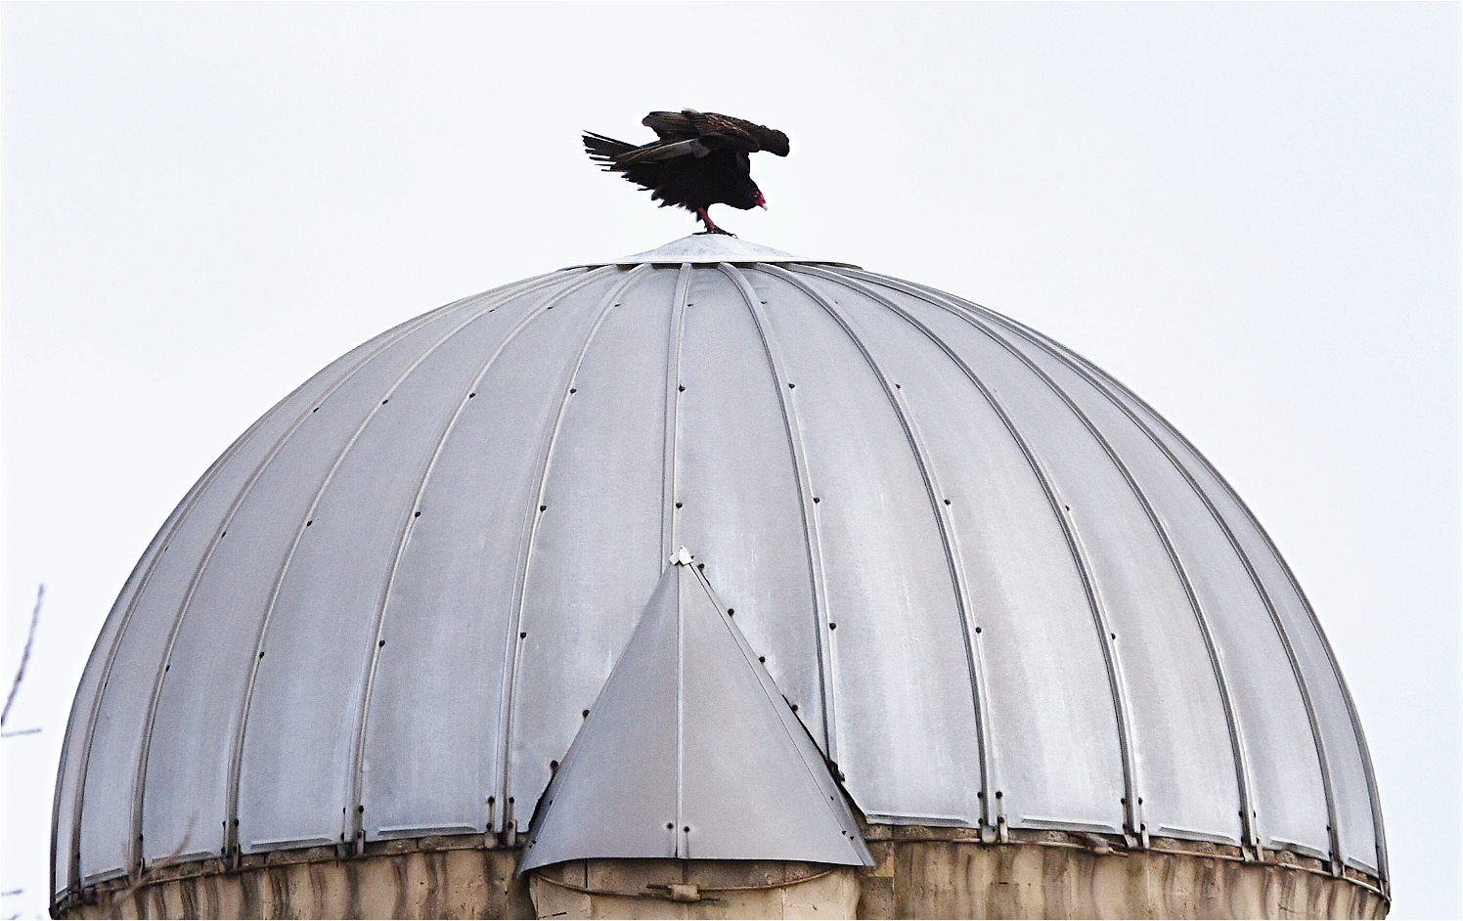
2024 Census – images

Slide 8
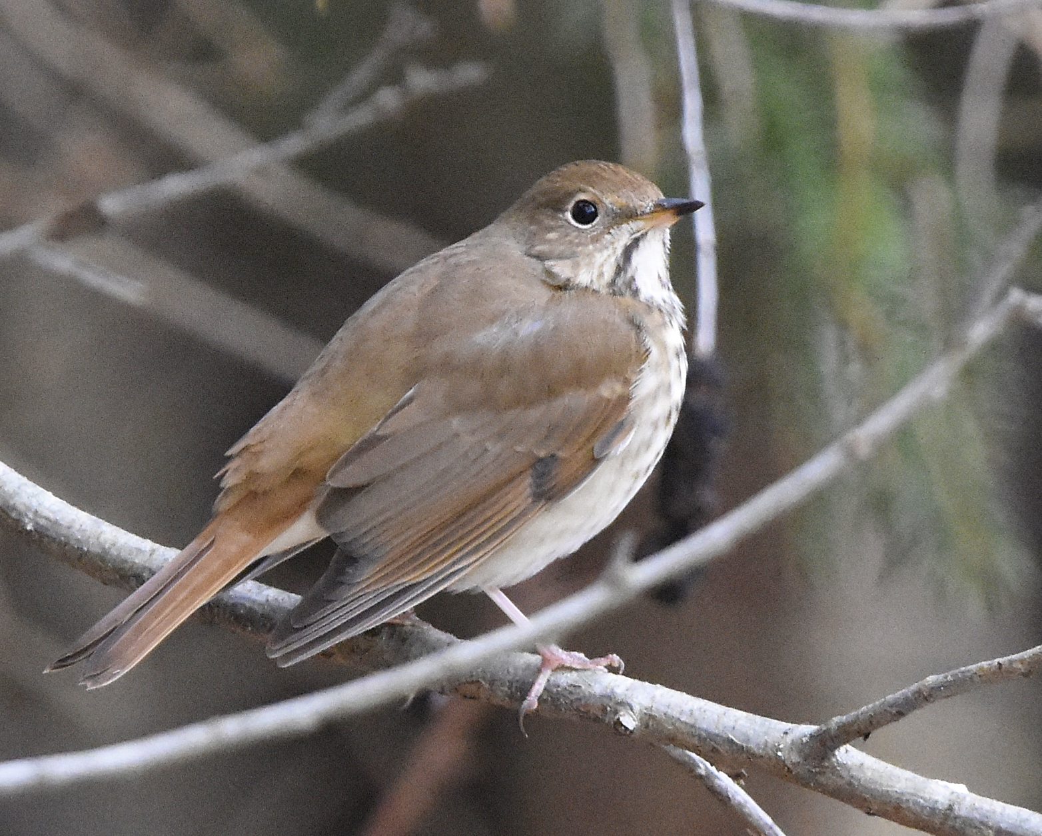
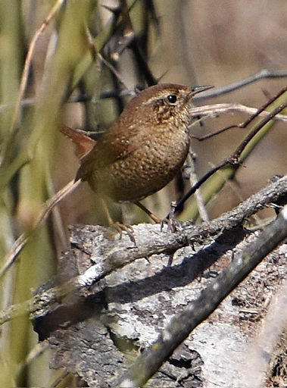
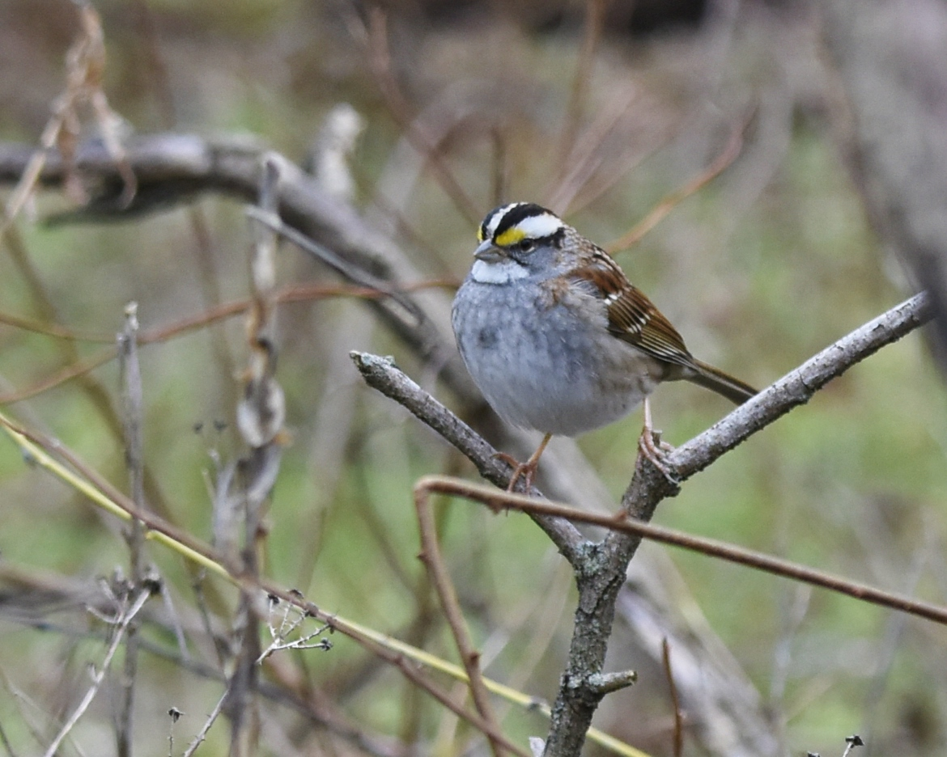
2024 Census – images

Slide 9
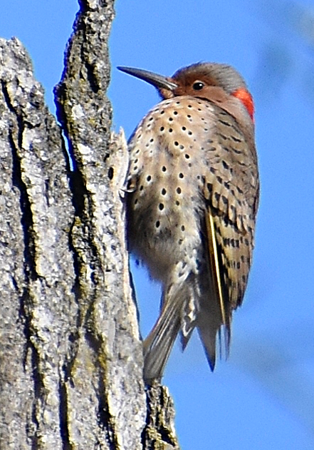
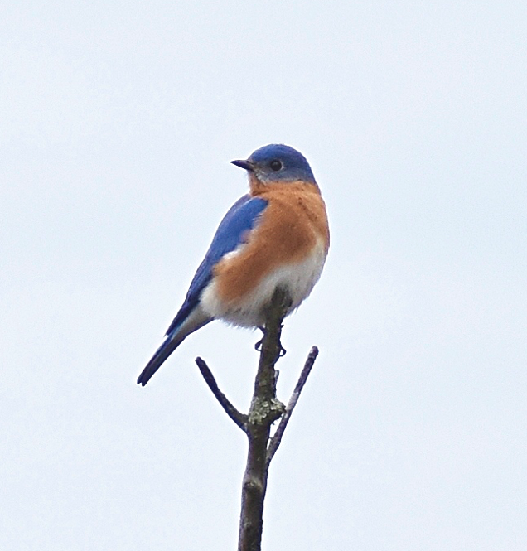
2024 Census – images

Slide 10
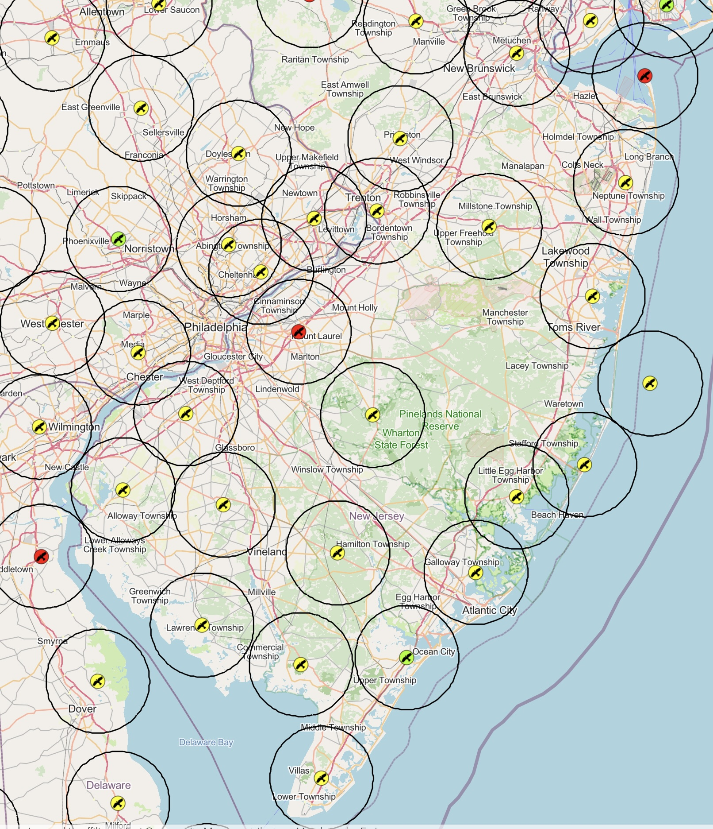
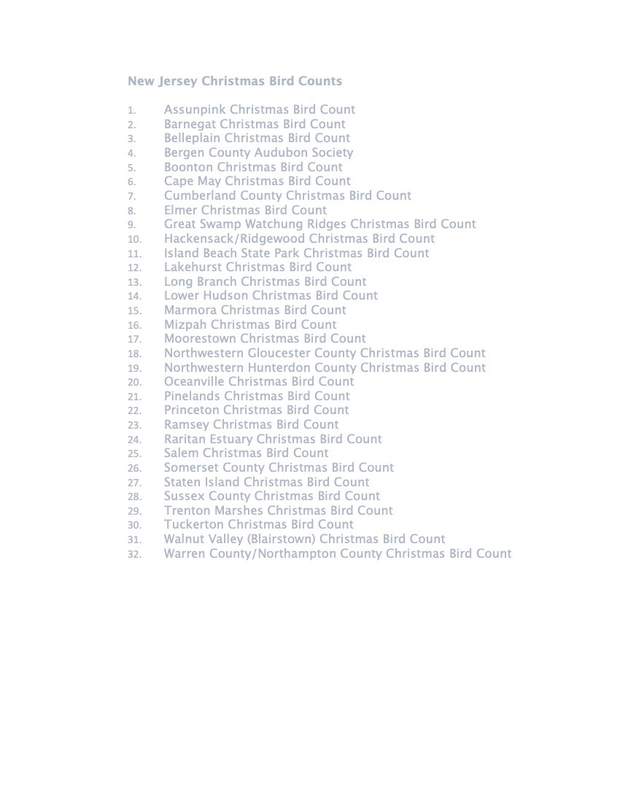
New Jersey Christmas Counts
Princeton has the oldest NJ count -- 1904
Cape May has the highest bird
and participant numbers
Many clubs and Audubon chapters
sponsor counts
Maps: https://gis.audubon.org/christmasbirdcount/
Narrative summary for last year, by Bill Boyle:
https://www.audubon.org/news/124th-christmas-bird-count-new-jersey-and-pennsylvania

Slide 11
Moorestown CBC
This was one of the earliest counts, conducted 1901-1934, then resumed 1993
There was no Moorestown CBC when Wayne Marshall began the Medford Leas winter census. I think that as a participant in the Cape May count for 60 years, he wanted to continue his tradition after he moved to Medford Leas

Slide 12
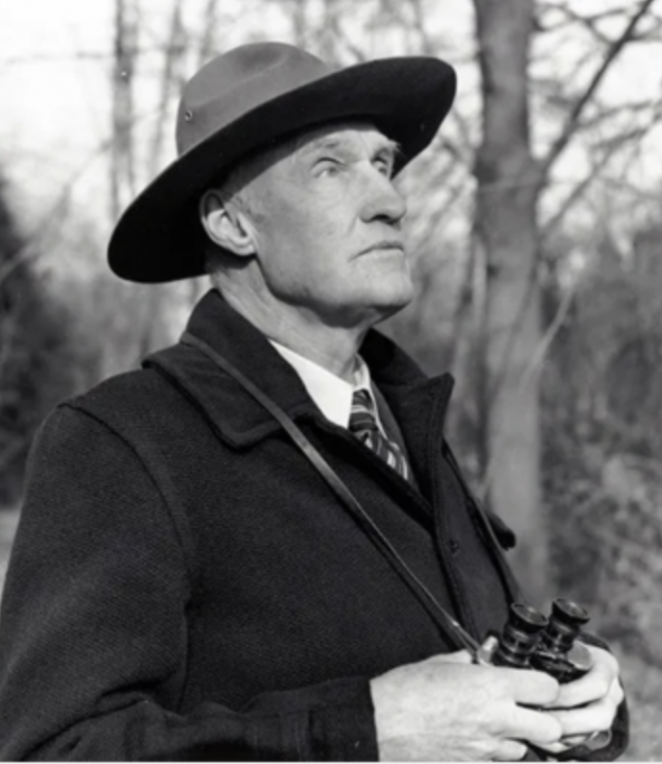
Princeton CBC
Charles Rogers, 1888 - 1977
Began in 1901
4 Compilers: Charles Rogers 1904-1963, Ray Blicharz 1963-1995, Laurie Larson 1996-2012, Brad Merritt 2013 to date
Tom Southerland, 95, remember Rogers, and walked his route with him in the 1960s

Slide 13
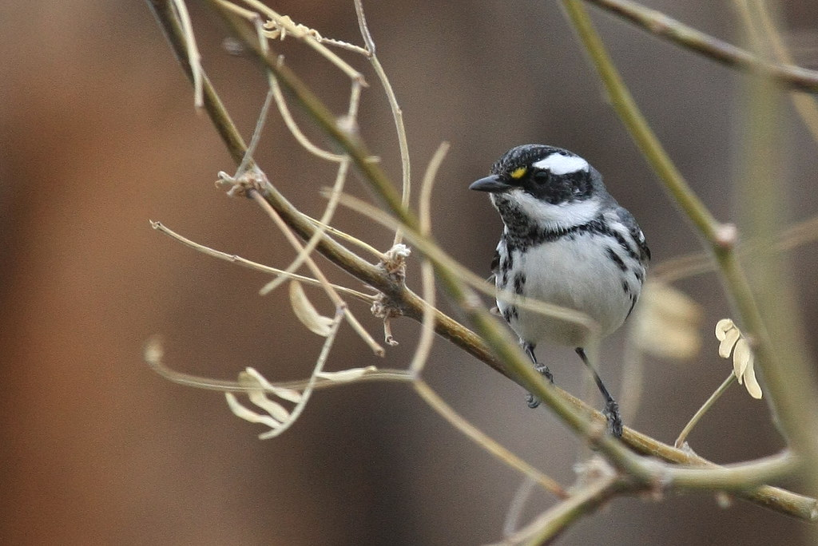
Princeton CBC
Changes over time
Increasing: Pileated Woodpecker, Carolina Wren, Raven, Bluebird
Decreasing: Owls, Raptors, Ruffed Grouse, Pheasant, Crows,
Blackbirds, winter finches, and many others
Black-throated Gray Warbler, 1981

Slide 14
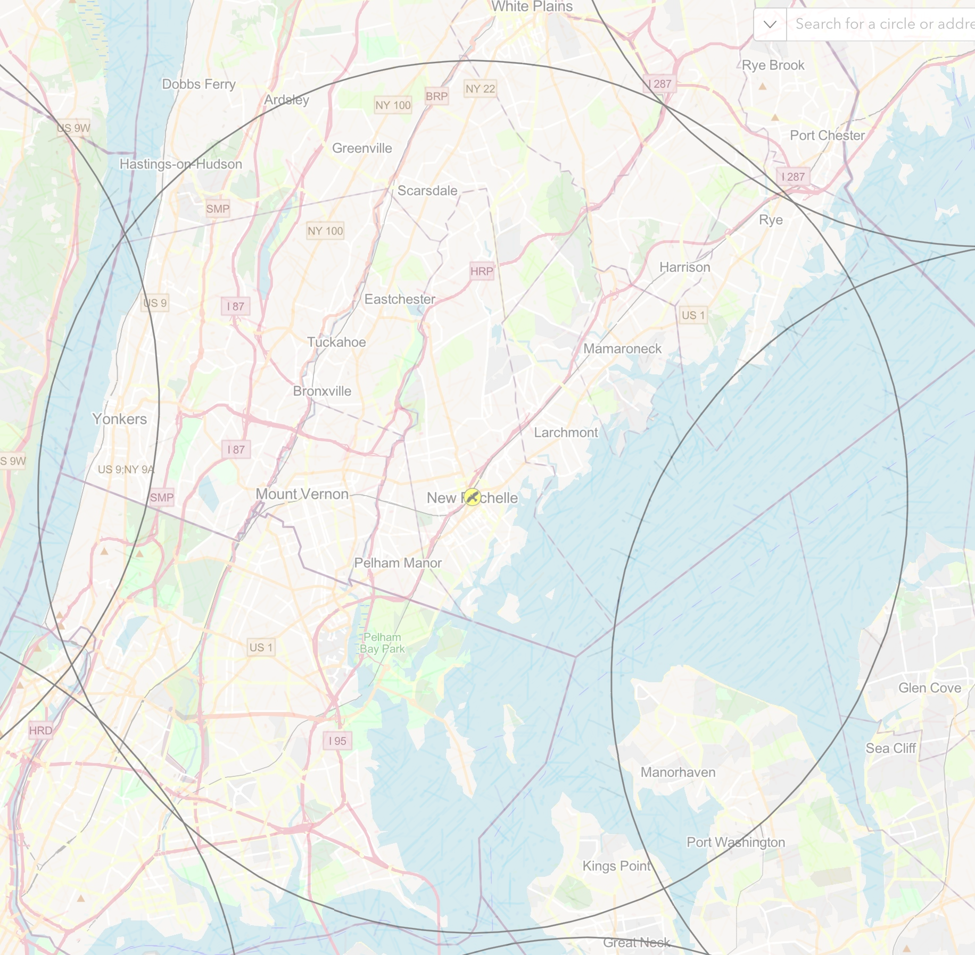
Bronx-Westchester CBC
Founded 1924
Bronx County Bird Club
Hudson River Audubon
https://www.hras.org/bronx-westchester-count
The Bronx-Westchester Christmas Bird Count
has been taking place since the
Bronx County Bird Club started it in 1924.

Slide 15
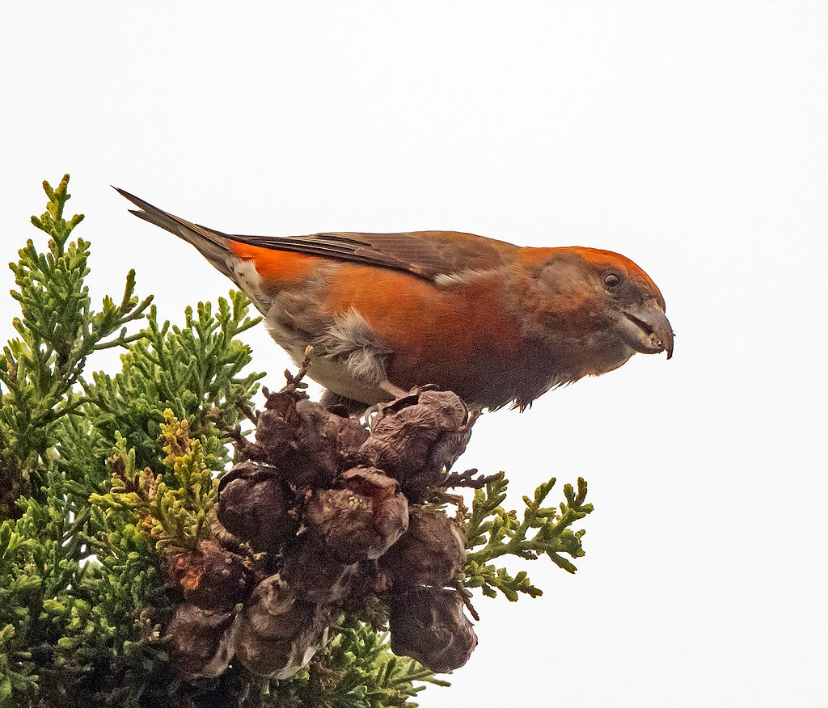
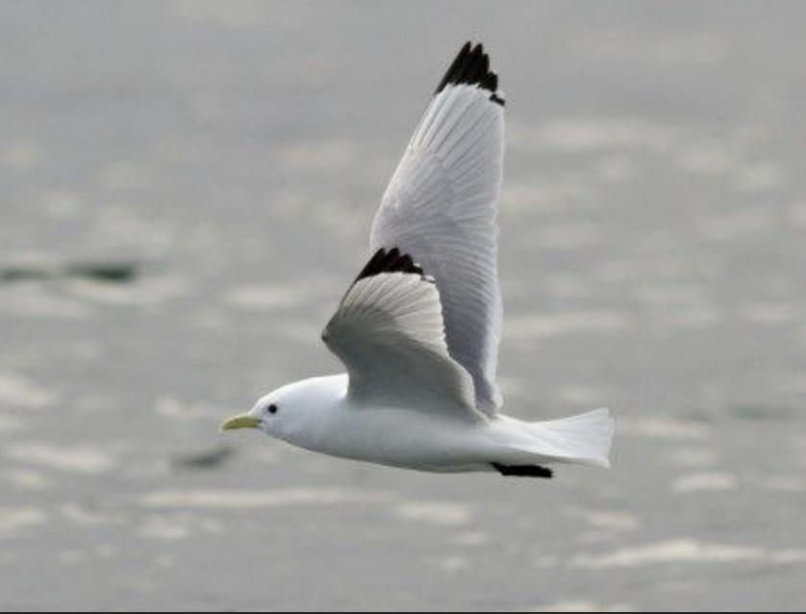
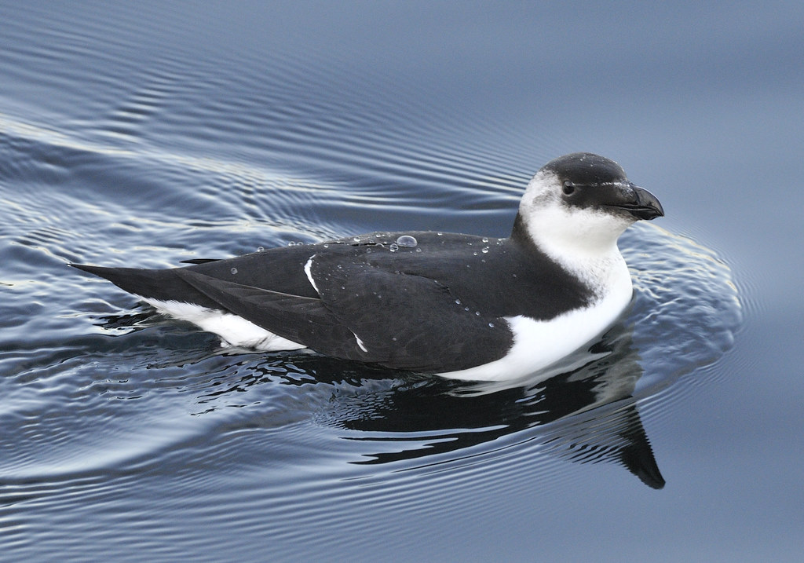
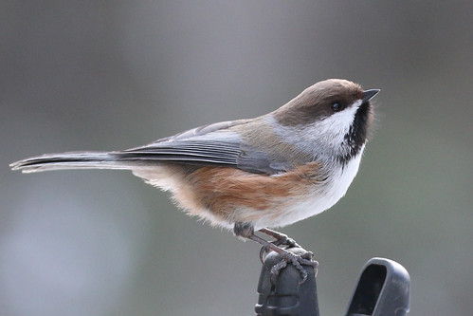
Downeast Maine CBCs
Machiasport, Jonesport, Eastport/Campobello
Alcids, gulls, seabirds
Winter finches, boreal forest birds

Slide 16
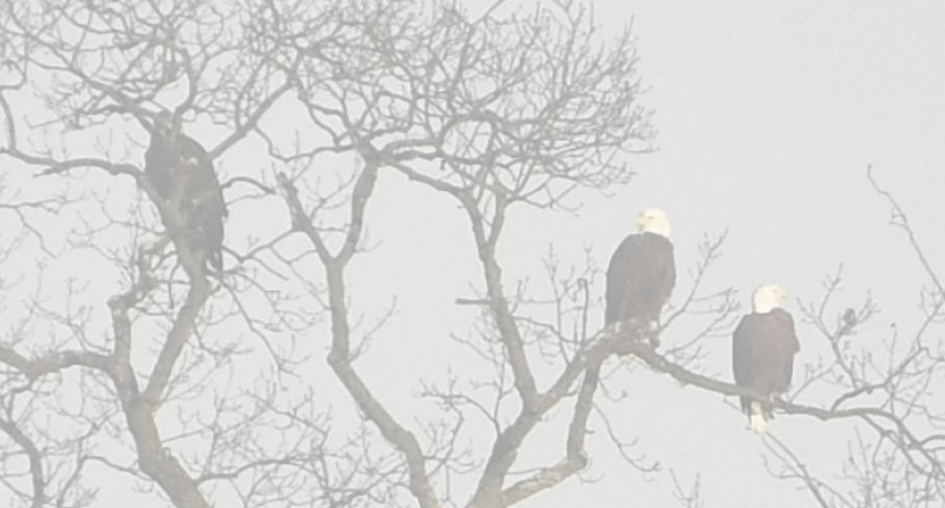
Viewing the data
You can see data for any count on the Audubon Website:
https://www.audubon.org/conservation/where-have-all-birds-gone
https://netapp.audubon.org/CBCObservation/CurrentYear/ResultsByCount.aspx
Original journals may be found in a large library:
Bird Lore
1899-1940
American Birds
1940-1994
National Audubon Society Field Notes
1994-1998
North American Birds
1999-2008

Slide 17
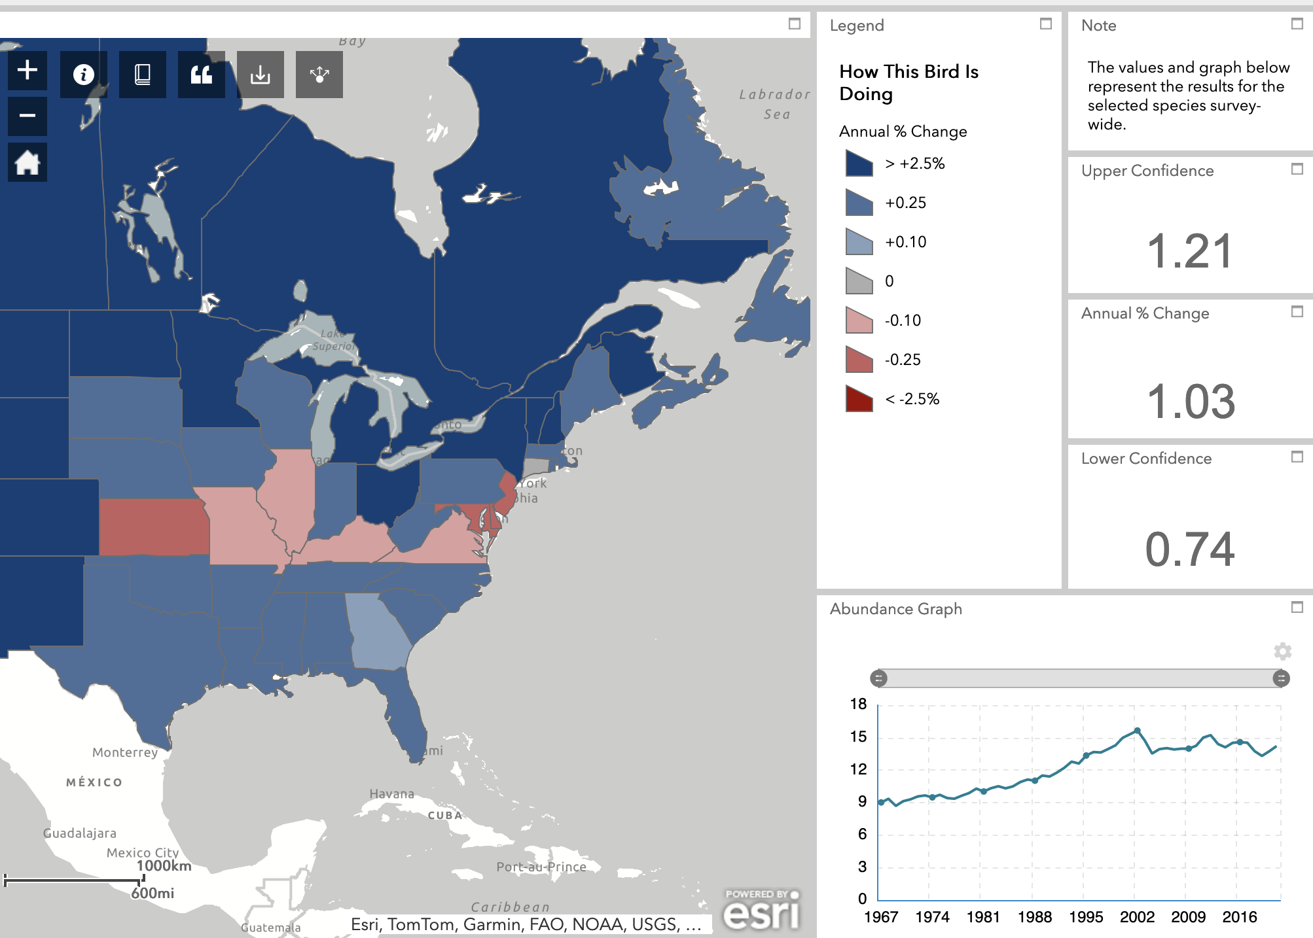
Viewing the data
https://www.audubon.org/community-science/christmas-bird-count/where-have-all-birds-gone
Example: American Crow

Slide 18
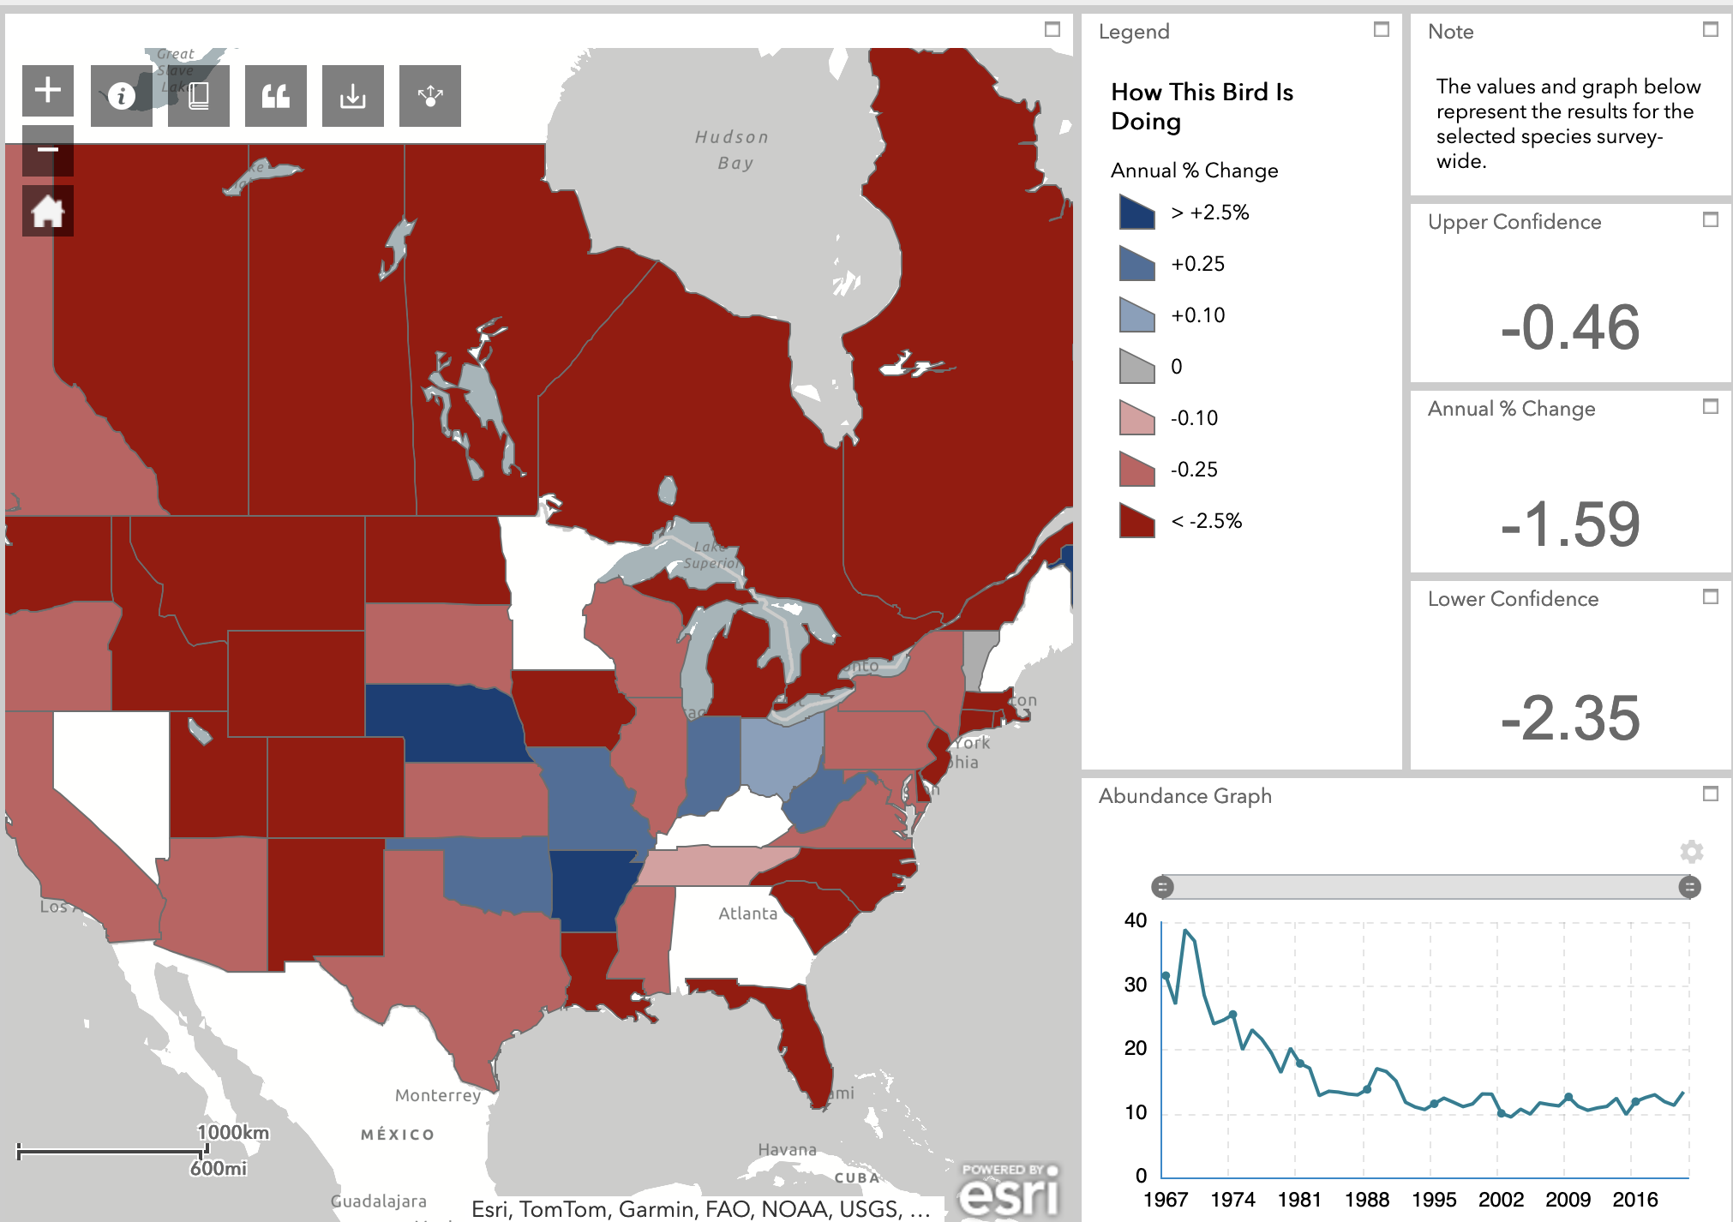
Viewing the data
https://www.audubon.org/community-science/christmas-bird-count/where-have-all-birds-gone
Example: Short-eared Owl

Slide 19
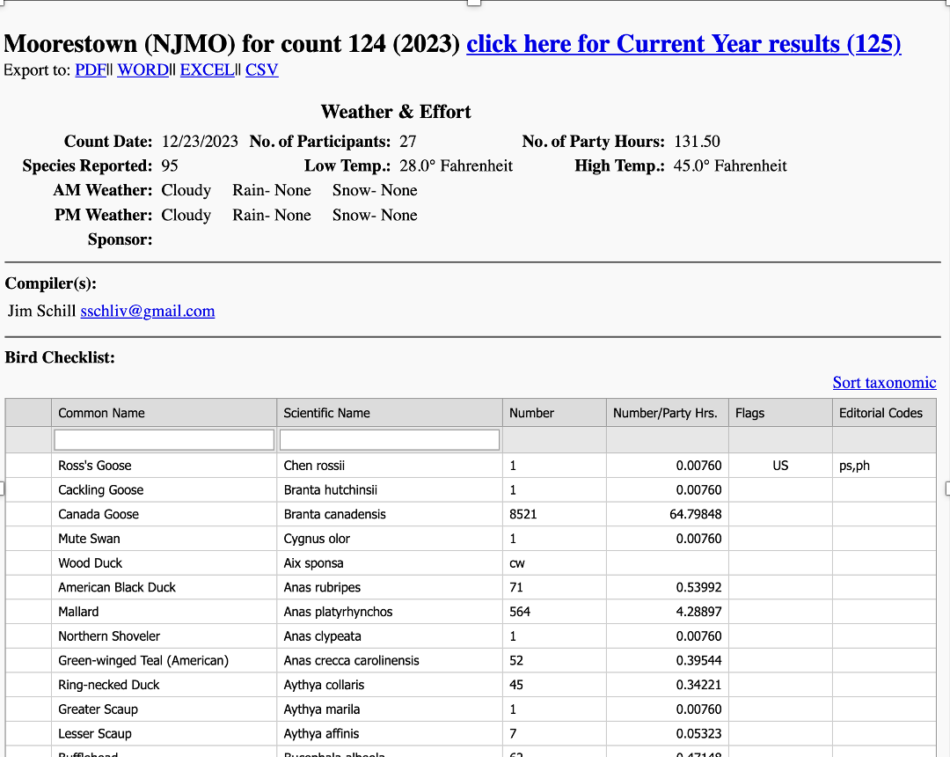
Viewing the data
https://netapp.audubon.org/CBCObservation/CurrentYear/ResultsByCount.aspx
Example:
Moorestown, 2023

Slide 20
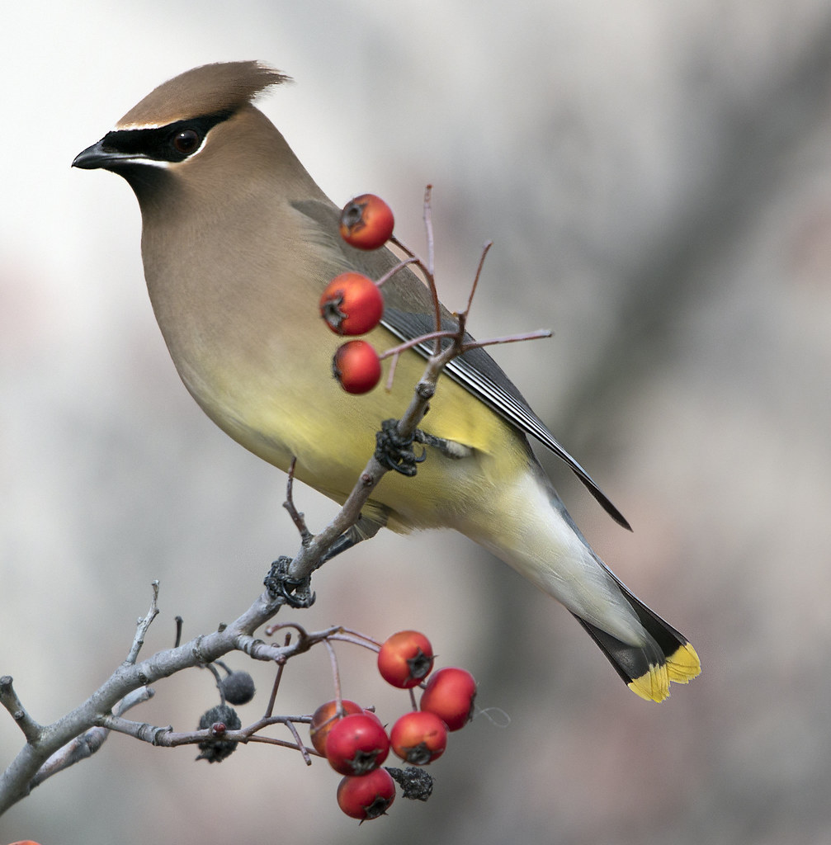
Summary – Christmas Count
Longest running Citizen Science project
One of the largest biological data sets
Other values include:
Strong traditions, community among birders
Education of public about birds and conservation
Conservation data that can help preserve birds

Slide 21
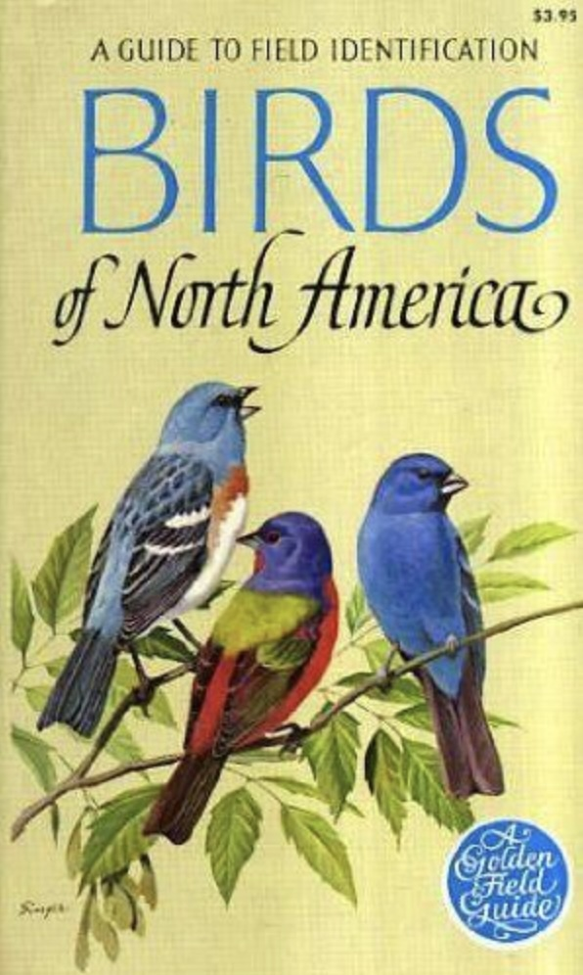
Video
Chandler Robbins, “Chan” (1918-2017)
Wrote the “Golden Guide”
Biologist with US FWS
Founded Breeding Bird Survey, Breeding Bird Atlas,
Bird Banding Lab
A longtime Christmas Count participant:
“Audubon's Christmas Bird Count told by Chan Robbins” from Audubon https://vimeo.com/71432056
https://www.youtube.com/watch?v=vFQJcCWj6O0

Slide 22
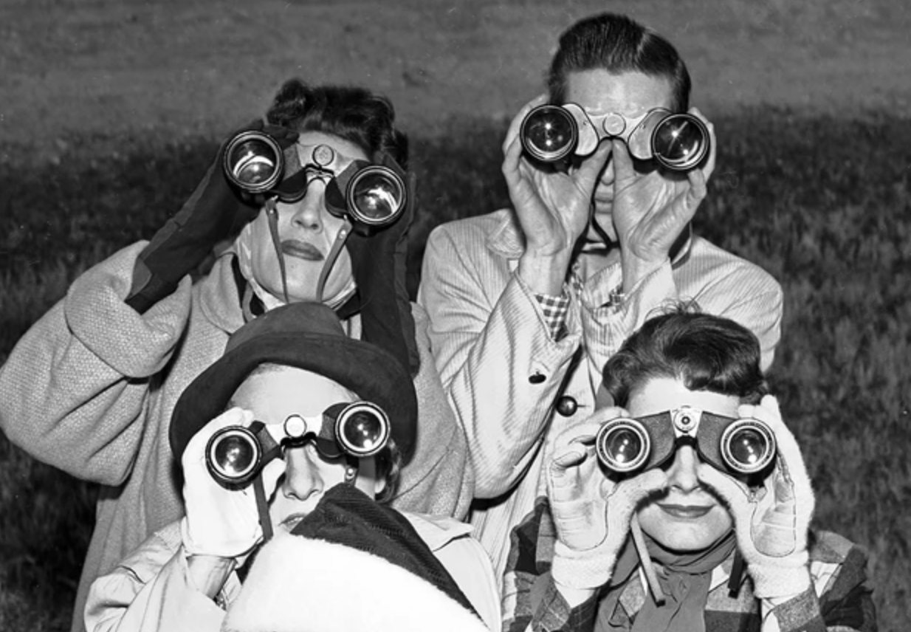
Do tell....
Have you ever been on a winter census or Christmas Bird Count?
Did you know Wayne Marshall?
Are you a count compiler?
What’s your favorite winter
birding story?

Slide 23
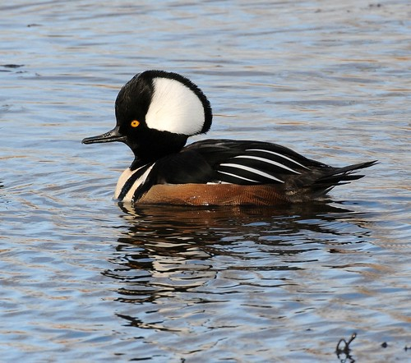
Questions?
Get in touch:
llarson2@mac.com
67 Woodside
609-647-2473
Many thanks to Robert Koch for use of his photos,
and to Ann Campbell for teaching me WordPress.

